Slide 1
Mathematical Practices
It's Elementary Math
Cadre

Slide 2
Double-click to enter title
www.reneeyates2math.com

Slide 3
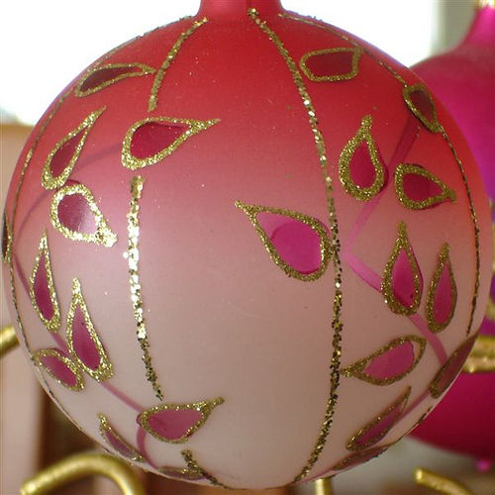
Targets
Identify and describe the common core standards for mathematical practice.
Recognize processes and skills of the mathematical practices students need to experience and demonstrate within mathematics tasks.

Slide 4
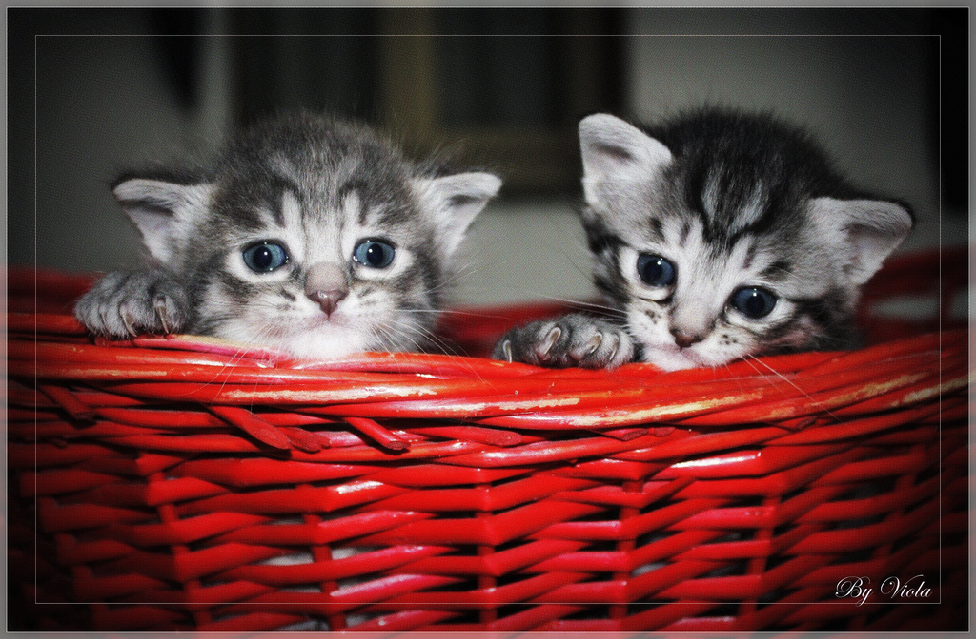
Having Kittens

Slide 5
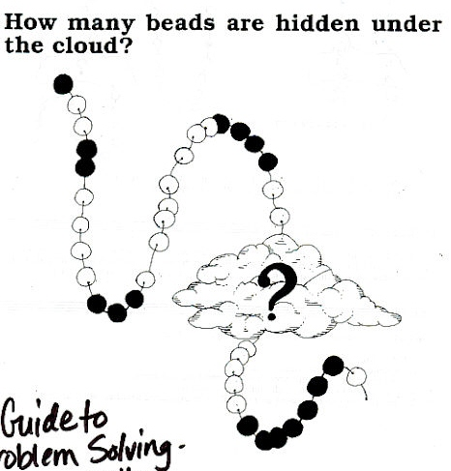
Beads Under a Cloud
Grade 4

Slide 6
Caterpillars and Leaves

Slide 7
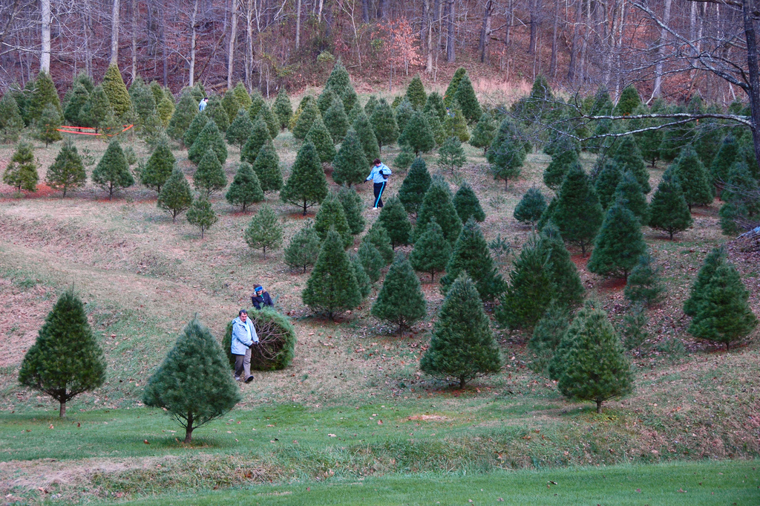
"Counting Trees"

Slide 8
Mathematical Practice 1
“Make sense of problems and persevere in solving them” (CCSS, 2010, p. 6).
Engaging students requires…
Selection of interesting problems
Students entry into problem supported by background and familiar knowledge
Opportunity for discourse as learners process pathways to solving problems

Slide 9
Mathematical Practice 2
“Reason abstractly and quantitatively” (CCSS, 2010, p. 6).
Engaging students requires…
Exposure to various quantities, their meanings, and representations
Opportunities to represent quantities abstractly

Slide 10
Mathematical Practice 3
“Construct viable arguments and critique the reasoning of others” (CCSS, 2010, p. 6).
Engaging students requires…
Establishing appropriate class community norms
Ample opportunity for sharing of ideas
Allowance of various perspectives and interpretations during discourse

Slide 11
Mathematical Practice 4
“Model with mathematics” (CCSS, 2010, p. 7).
Engaging students requires…
Connecting mathematics to every day life
Acceptance of approximations
Expression of meaning in various formats (e.g., tables, graphs, formulas, etc.)

Slide 12
Mathematical Practice 5
“Use appropriate tools strategically” (CCSS, 2010, p. 7).
Engaging students requires…
Availability of a variety of tools and models for students to use
Support of students’ development for selecting and using tools
Allowing tangible (e.g., ruler) as well as intangible (e.g., Internet) tools

Slide 13
Mathematical Practice 6
“Attend to precision” (CCSS, 2010, p. 7).
Engaging students requires…
Opportunity for developing skill of explanation
Close examination and careful use of definitions
Practice of mathematical calculations

Slide 14
Mathematical Practice 7
“Look for and make use of structure” (CCSS, 2010, p. 8).
Engaging students requires…
Composing and decomposing of mathematical ideas
Allowing various perspectives/interpretations where the integrity of the mathematics is still intact
Looking for a pattern

Slide 15
Mathematical Practice 8
“Look for and express regularity in repeated reasoning” (CCSS, 2010, p. 8).
Engaging students requires…
Close examinations of the processes of calculations
Giving attention to details
Applying extended reasoning with patterns "What would the 20th term in a pattern be?"

Slide 16
Understanding with Fidelity is Key to Success
“…a lack of understanding effectively prevents a student from engaging in the mathematical practices” (CCSS, 2010, p. 8).

Slide 17
Homework Review
Analyze the student behaviors depicting the mathematical practices you observed during the open task you brought to share.
How are the behaviors congruent to the identified practice(s)?

Slide 18
"12 Days of Christmas"
How many gifts did my true love give to me on the 12 days of Christmas?

